Slide 1



2023 IEEE International Conference on
Contemporary Computing and Communications (InC4)
Paper ID :
“Customer Segmentation Analysis leveraging Machine Learning Algorithms”
Presented by: Mr. HARIRAM S
Authored by: Raja Subramanian R, Dhanasekaran S, Hariram S, Kamalakannan P, Ishvarya M, Maturu Tejeswar Reddy

Slide 2
Agenda
Introduction
Literature review
Motivation and Problem statement
Objectives
Methodology
Result Discussion
Limitations
Future Enhancement
Conclusion
References

Slide 3
Introduction
Customer Segmentation is a way of separating the customers based on their characteristics or spending nature.
In our research, we have produced nine clustering based machine learning models which will be able to classify the customers based on their spending nature or characteristics.
We have used methods like Cohort Analysis, Pareto Principle (80-20 Rule), and RFM Analysis (Recency, Frequency, Monetary) for the segmentation of the customers.

Slide 4
Literature Survey
S.No | Title | Author and Journal details | Findings | Research gaps/ Limitations
[1] [2] | RFM model for customer purchase behavior using K-Means algorithm Lifestyle segmentation of tourists: the role of personality | P. Anitha, Malini M. Patil Elena Parra Vargas, Carla de-Juan-Ripoll, Marta Bueno Panadero, Mariano Alcañiz | They have trained their model by K-Means clustering algorithm. They have used RFM analysis for segmenting the customers. They were segmenting the customers based on their lifestyle. It is based on their personality and training the model for the purpose of tourism. | They have only trained their model based on one clustering model. They haven’t used many separation methods for segmentation of customers. They weren’t considered many aspects in the personality of a person in segmentation. There are no much findings in the tourism based segmentation of customers.

Slide 5
Literature Survey (Cont…)
S.No | Title | Author and Journal details | Findings | Research gaps/ Limitations
[3] [4] | Capturing Retailers’ Brand and Customer Focus Deep Learning as a Vector Embedding Model for Customer Churn | Simeng Han, Werner Reinartz, Bernd Skiera Tjeng Wawan Cenggoro, Raditya Ayu Wirastari, Edy Rudianto, Mochamad Ilham Mohadi, Dinne Ratj, Bens Pardamean | They have told that how retailers capture the market and how they were aiming the customers They were also using RFM analysis. They have used Vector Embedding Model for the segmentation of the customers They have used the deep learning methods for solving the problem. They have used both RFM Analysis and Pareto Principle. | They haven’t told anything about how its all being done in the real-world scenarios. They have limitations in the segmenting the people because they only use RFM Analysis. Even they have used deep learning for their problem statement they haven’t achieved much in segmentation of customers. Vector Embedding Model is not much useful in terms of Customer Segmentation.

Slide 6
Motivation
In Supermarket or any other e-commerce we will buy items which we wish. Now some type of revenue for the company will be generated.
Just segment the customers based on their interest and spending nature and now another type of revenue will be generated.
In that time, both the customers and company will be happy with it.
This is our motivation to do a research based on it.

Slide 7
Objective
We need to segment our customers based on their spending nature and their demographic details.
Apply different types of principles for segmenting the customers.
Create the models for segmenting the customers and the suitable algorithm is clustering.
Finally, save the best model for the future use in the market.

Slide 8
Methodology
Segmenting the customers based on Cohort Analysis (Time Cohort, Behavior Cohort and Size Cohort)
Pareto Principle Analysis (80 – 20 Rule) for segmentation of customers.
RFM Analysis (Recency, Frequency and Monetary) plays a vital role in segmentation.
After the analysis part, they will be sent for fitting the model in the various clustering methods.
Finally, the best model will be saved for our future use.

Slide 9
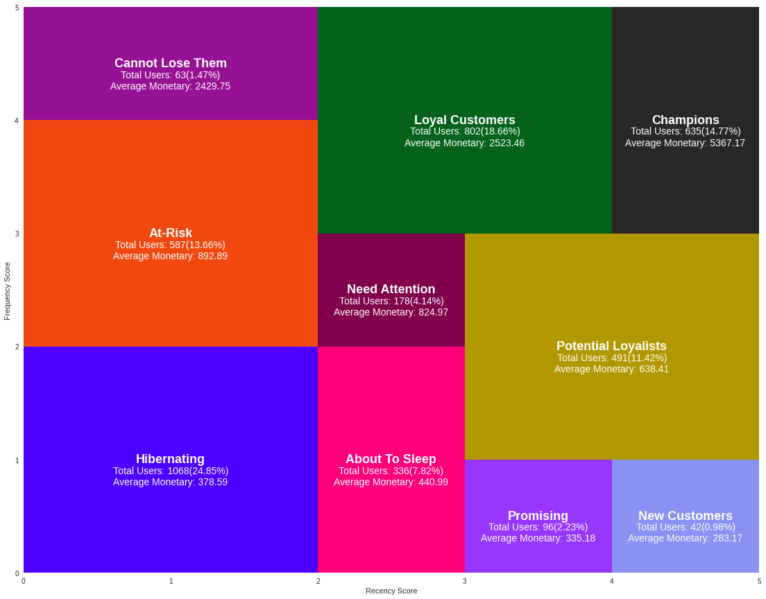
Result Discussion
We have segmented our customers based on the methodology which we have previously seen.

Slide 10
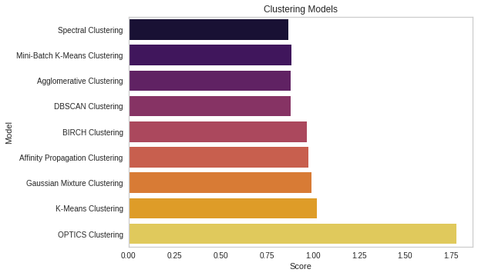
Result Discussion (Cont…)
We have compared 9 clustering models for our research and we have got good result in Spectral Clustering Model.

Slide 11
Limitations
In our research, we have considered spending nature and behavior of the customer alone.
We have not taken any customer reviews regarding the data, the dataset is predefined in UCI Machine Learning Repository.
If any other kind of inputs given to the model, it may not perform better.
We don’t have proper information regarding the reviews of the customers.

Slide 12
Future Enhancement
Our research can be extended with Market Basket Analysis which can help the customers to buy more things than usual and the revenue of the company will be increased.
It can be extended with respect to customer reviews using sentiment analysis for knowing about the customer more.
The previously mentioned limitations can be taken as our future scope of this research.

Slide 13
Conclusion
At the end, we would like to say that our models can be used for segmentation of the customers in any of the field.
We have given a new perspective to the future researchers to use some great analysis for the customers.
Combining our analysis may result in good segmentation of the customers.
Our top models can be used in the market for the use of the companies for better knowing about the customers.

Slide 14
References
P. Anitha, Malini M. Patil, RFM model for customer purchase behavior using K-Means algorithm, Journal of King Saud University - Computer and Information Sciences, Volume 34, Issue 5, 2022, Pages 1785-1792, ISSN 1319-1578, https://doi.org/10.1016/j.jksuci.2019.12.011
Zhen You, Yain-Whar Si, Defu Zhang, XiangXiang Zeng, Stephen C.H. Leung, Tao Li, A decision-making framework for precision marketing, Expert Systems with Applications, Volume 42, Issue 7, 2015, Pages 3357-3367, ISSN 0957-4174, https://doi.org/10.1016/j.eswa.2014.12.022
Elena Parra Vargas, Carla de-Juan-Ripoll, Marta Bueno Panadero, Mariano Alcañiz, Lifestyle segmentation of tourists: the role of personality, Heliyon, Volume 7, Issue 7, 2021, e07579, ISSN 2405-8440, https://doi.org/10.1016/j.heliyon.2021.e07579
Tjeng Wawan Cenggoro, Raditya Ayu Wirastari, Edy Rudianto, Mochamad Ilham Mohadi, Dinne Ratj, Bens Pardamean, Deep Learning as a Vector Embedding Model for Customer Churn, Procedia Computer Science, Volume 179, 2021, Pages 624-631, ISSN 1877-0509, https://doi.org/10.1016/j.procs.2021.01.048
Nigel Halpern, Deodat Mwesiumo, Thomas Budd, Pere Suau-Sanchez, Svein Bråthen, Segmentation of passenger preferences for using digital technologies at airports in Norway, Journal of Air Transport Management, Volume 91, 2021, 102005, ISSN 0969-6997, https://doi.org/10.1016/j.jairtraman.2020.102005
Simeng Han, Werner Reinartz, Bernd Skiera, Capturing Retailers’ Brand and Customer Focus, Journal of Retailing, Volume 97, Issue 4, 2021, Pages 582-596, ISSN 0022-4359, https://doi.org/10.1016/j.jretai.2021.01.001

Slide 15



